Slide 1
LONGEST COMMON SUBSTRING
Using:
1)Naïve approach
2)2D arrays(Dynamic Programming)
3)Suffix Tree
By:
Saurabh Kumar Singh(16075045)
Shrey Tanna(16075051)
Shorya Jain(16075050)
Shreyansh Singh(16075052)
Notes:
This presentation demonstrates the new capabilities of PowerPoint and it is best viewed in Slide Show. These slides are designed to give you great ideas for the presentations you’ll create in PowerPoint 2010!
For more sample templates, click the File tab, and then on the New tab, click Sample Templates.

Slide 2
Introduction:
In computer science, the longest common substring problem is to find the longest
string (or strings) that is a substring (or are substrings) of two or more strings.

Slide 3
Naïve approach:
Algorithm:
Let A and B be the given strings of length m and n respectively. We would first find the substrings in string A of lengths 1…m and then check if they are present in string B or not , if present then we would return the maximum of those substring lengths.
max := 0
for i in 1..m:
for j in 0..m-i:
if substring A[j:j+i] in B and max<j-i:
max:=j-i
return max
Time Complexity : O(n*m^2)

Slide 4
Dynamic Programming:
Dynamic Programming can be used to find the longest common substring in O(m*n) time and O(m*n) space. The idea is to find length of the longest common suffix for all substrings of both strings and store these lengths in a table.
The longest common suffix has following optimal substructure property.
LCSuff(X, Y, m, n) = LCSuff(X, Y, m-1, n-1) + 1 if X[m-1] = Y[n-1]
0 if X[m-1] != Y[n-1]
The maximum length Longest Common Suffix is the longest common substring.
LCSubStr(X, Y, m, n) = Max(LCSuff(X, Y, i, j)) where 1 <= i <= m
and 1 <= j <= n

Slide 5
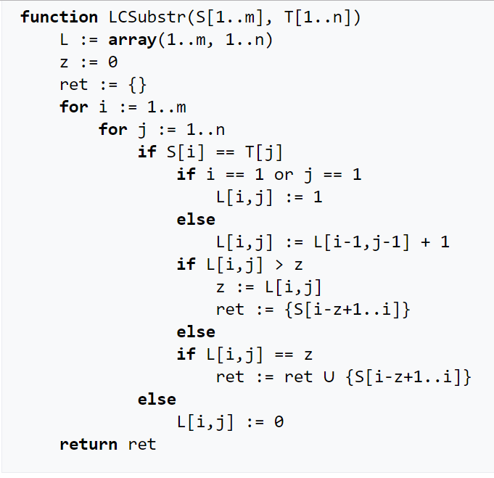
Pseudocode

Slide 6
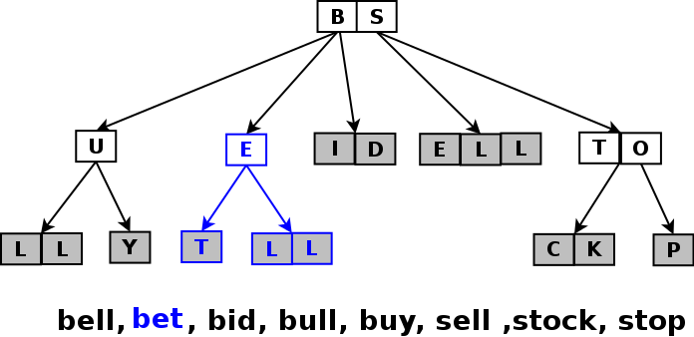
Suffix Tree
A Suffix Tree for a given text is a compressed trie for all suffixes of the given text.
Compressed Trie is obtained from standard trie by joining chains of single nodes. The nodes of a compressed trie can be stored by storing index ranges at the nodes.

Slide 7
Suffix Tree
How to build a Suffix Tree for a given text?
1) Generate all suffixes of given text. 2) Consider all suffixes as individual words and build a compressed trie
How to search a pattern in the built suffix tree?
Following are abstract steps to search a pattern in the built Suffix Tree. 1) Starting from the first character of the pattern and root of Suffix Tree, do following for every character. …..a) For the current character of pattern, if there is an edge from the current node of suffix tree, follow the edge. …..b) If there is no edge, print “pattern doesn’t exist in text” and return. 2) If all characters of pattern have been processed, i.e., there is a path from root for characters of the given pattern, then print “Pattern found”.

Slide 8
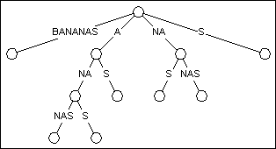
Suffix Tree
Example of a suffix tree for the string BANANA :

Slide 9
Generalised suffix tree:
A suffix tree for two or more than two strings is called a generalised suffix tree.
We separate these strings by sentinel values like $, #, etc.
Lets consider two strings X and Y for which we want to build generalized suffix tree. For this we will make a new string X#Y$ where # and $ both are terminal symbols (must be unique). Then we will build suffix tree for X#Y$ which will be the generalized suffix tree for X and Y. Same logic will apply for more than two strings (i.e. concatenate all strings using unique terminal symbols and then build suffix tree for concatenated string).
Lets say X = ‘xabxa’, and Y = ‘babxba’, then X#Y$ = ‘xabxa#babxba$’

Slide 10
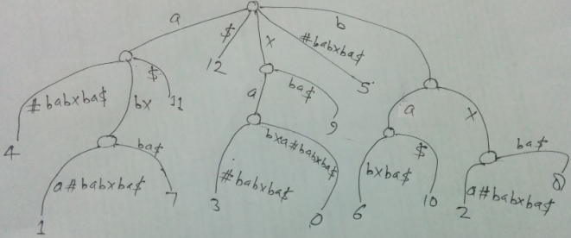
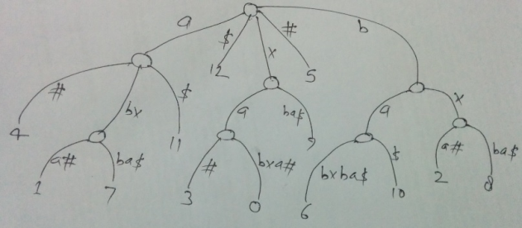
Generalised suffix tree for X=‘xabxa’ and Y=‘babxba’

Slide 11
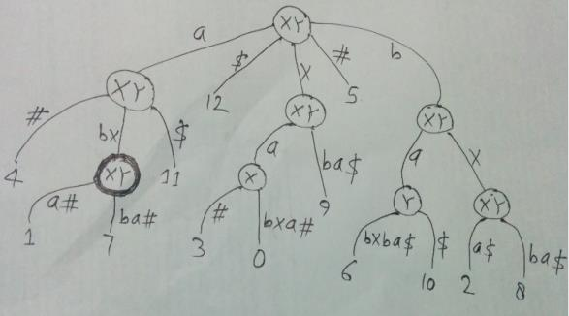
We can see that in the generalized suffix tree figure above, there are some internal nodes having leaves below it from both strings X and Y (i.e. there is at least one leaf with suffix index in [0,4] and one leaf with suffix index in [6, 11]
string X only (i.e. all leaf nodes have suffix indices in [0,4])
string Y only (i.e. all leaf nodes have suffix indices in [6,11])
Following figure shows the internal nodes marked as “XY”, “X” or “Y” depending on which string the leaves belong to, that they have below themselves.
Path label from root to an internal node gives a substring of X or Y or both. For node marked as XY, substring from root to that node belongs to both strings X and Y. For node marked as X, substring from root to that node belongs to string X only. For node marked as Y, substring from root to that node belongs to string Y only.

Slide 12
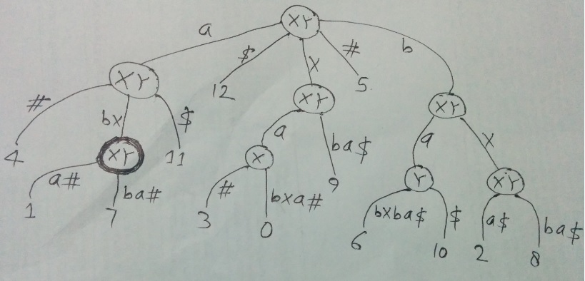
The path label from root to the deepest node marked as XY will give the LCS of X and Y. The deepest node is highlighted in above figure and path label “abx” from root to that node is the LCS of X and Y.

Slide 13
Comparison
 | Naïve Approach | Dynamic Programming | Suffix Tree
Time Complexity | O(n*m^2) | O(m*n) | O(m+n)
Space Complexity | O(m+n) | O(m*n) | O(m+n)
Use of memory | Better Caching | Better Caching | Use of heap

Slide 14
Applications
Queries for substring check, searching all patterns, longest repeated substring and built suffix array (All linear time operations).
There are lots of other problems where multiple strings are involved. e.g. pattern searching in a text file or dictionary, spell checker, phone book, Autocomplete, Longest common substring problem, Longest palindromic substring and more.
Used in computational biology.
e.g. DNA substrand matching etc.

Slide 15


